Slide 1
Capstone Project to explore Toronto venues by Vegetarian/vegan category

Slide 2
Content
Introduction
Data source and cleaning
Result
Discussion
Conclusion

Slide 3
Introduction
Toronto is the capital city of the Canadian province of Ontario
Toronto is the leading tourism destination in Canada. In 2018, Toronto welcomed over 27.5 million visitors.
. Total hotel nights sold reached 6.4 million. $6.5 billion dollars in visitor spending.

Slide 4
Vegetarian and vegan
Vegetarian and vegan dietary practices vary among countries
Some surveys predict by 2025 25% of world population opt for vegetarian/vegan food.
However, finding vegetarian/Vegan food option is one of the challenges for vegetarian/vegan tourist

Slide 5
Data source and cleaning
Data Using Beautiful Soup Scraping List of Postal Codes of Given Wikipedia Page (Name and postal code)
Regression method to learn and predict number of the Vegetarian /vegan restaurant in a neighborhood by providing the venues information of Toronto City
Venues information is discovered from Foursquare API.

Slide 6
Data source and cleaning
Grouped category of restaurant per neighborhood and plotted graph by category to explore each category restaurant and then grouped to per vegetarian/vegan category to see predicted business option for vegetarian/vegan venue.

Slide 7
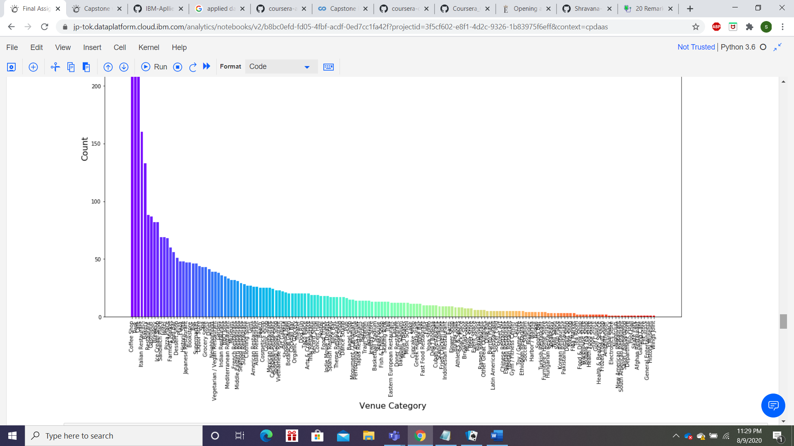
Result
As per graphical representation it is observed that Coffee shop are in highest number across the city and vegetarian/vegan restaurant is in top 30 of the list. However, with less than 50 in total number

Slide 8
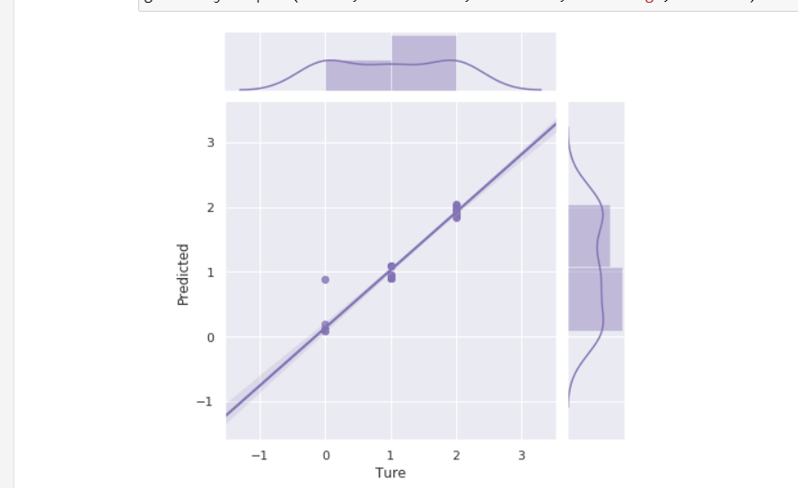
Discussion and conclusion
It is observed that in each neighborhood there are only 1-2 venues which are vegetarian/vegan. This represents great opportunity for new business of vegetarian/vegan restaurant or to include it in as one of the option in existing restaurant to improve business .

